Slide 1



Sales dashboard
View in Power BI
Last data refresh:
19/04/2024 12:20:44 UTC
Downloaded at:
19/04/2024 12:22:42 UTC

Slide 2
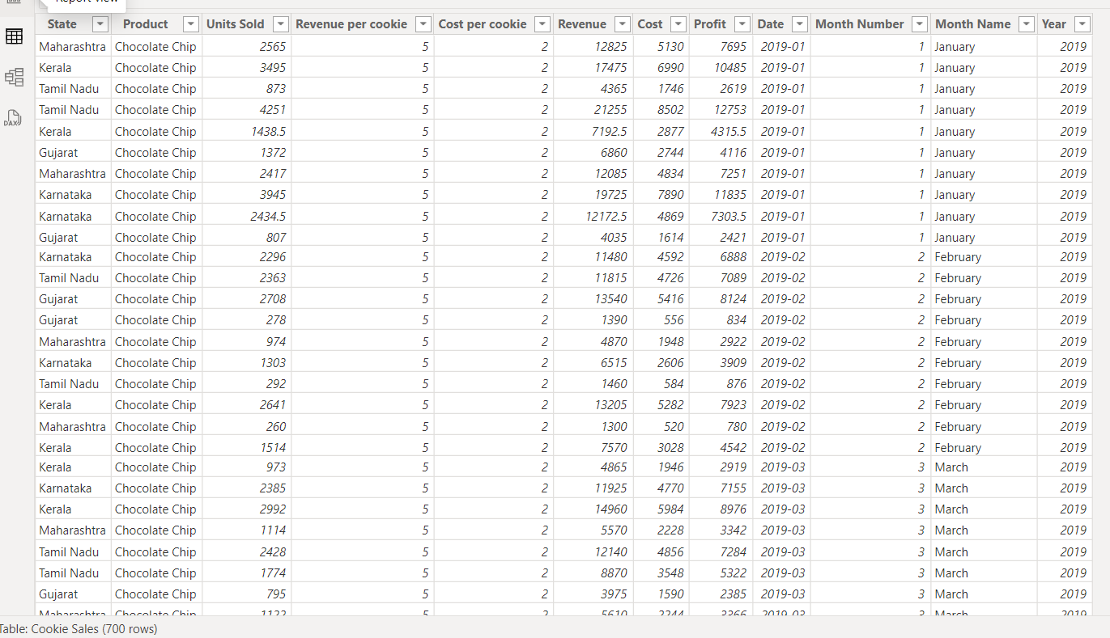

Slide 3
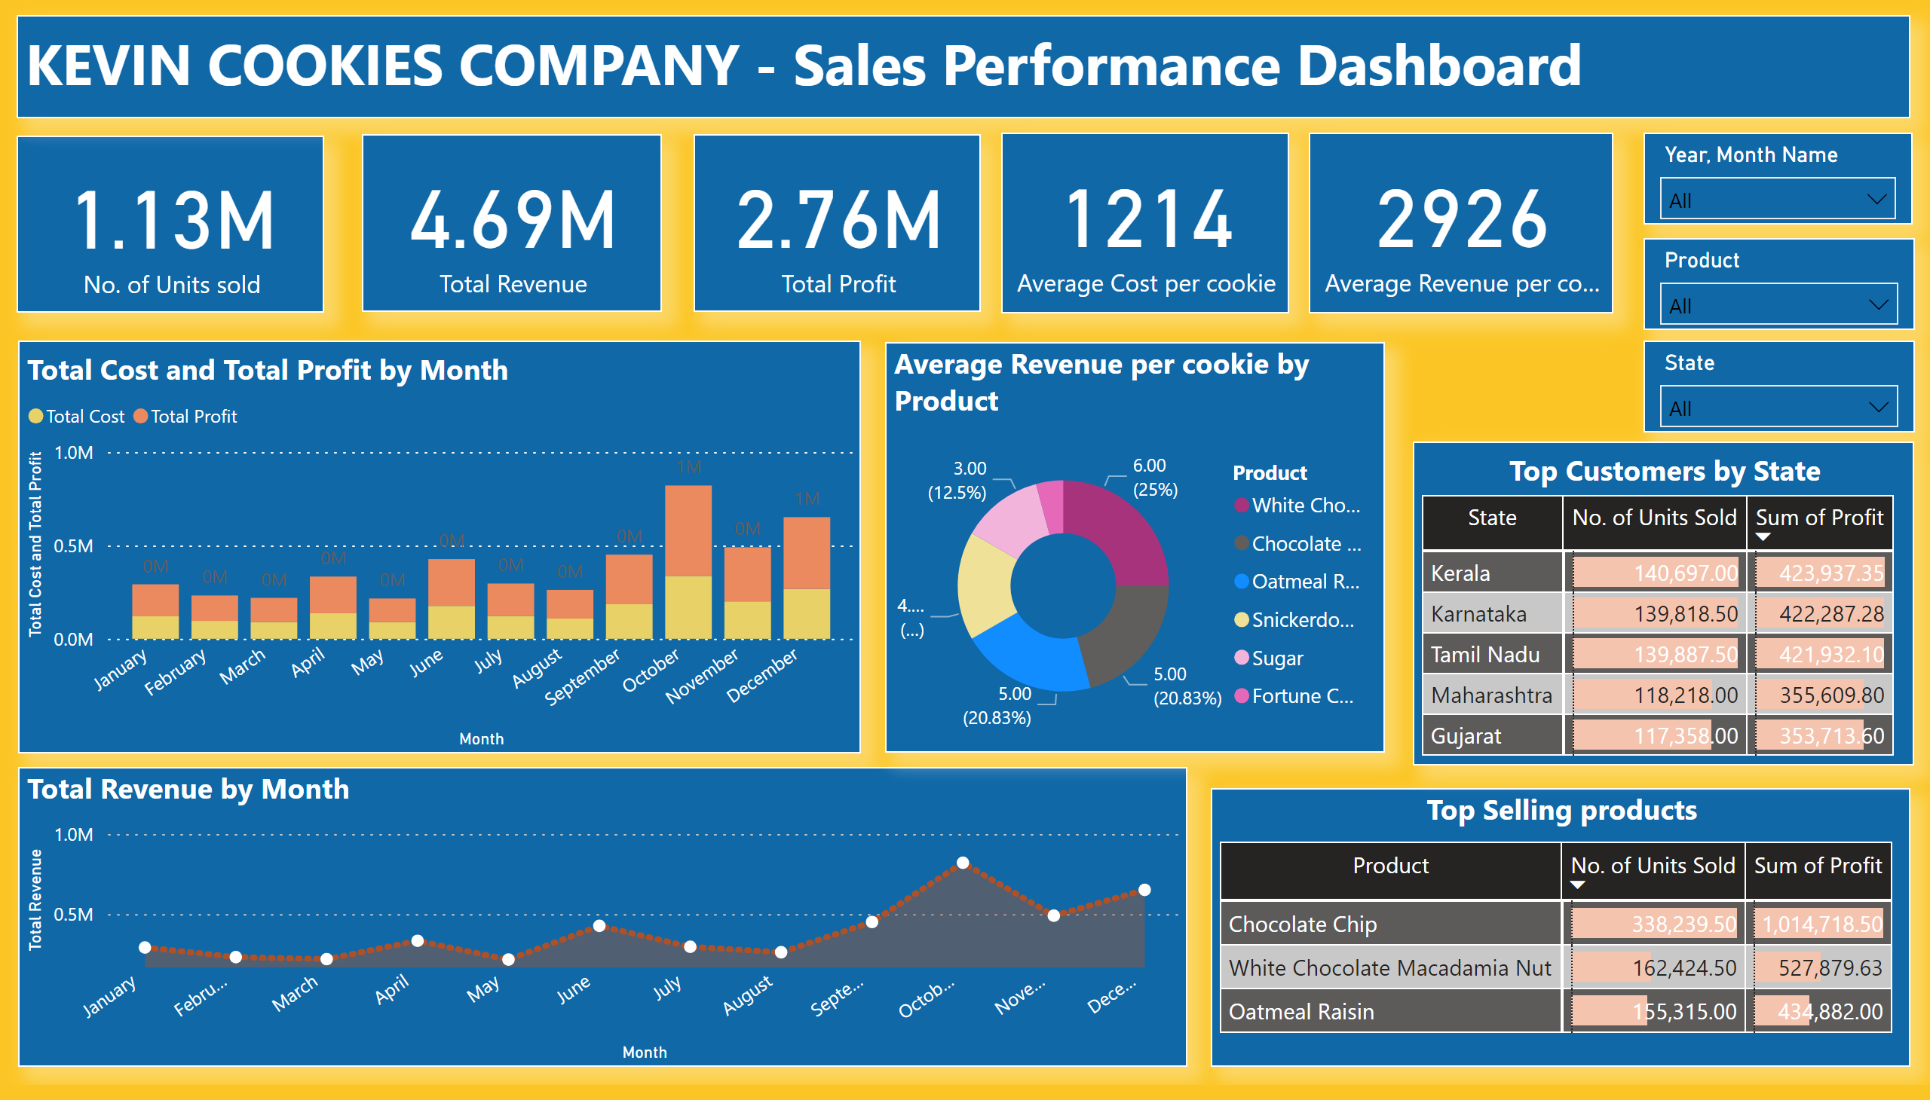
Page 1
Notes:
card
No alt text provided
textbox
No alt text provided
card
No alt text provided
card
No alt text provided
slicer
No alt text provided
columnChart
No alt text provided
slicer
No alt text provided
slicer
No alt text provided
card
No alt text provided
card
No alt text provided
areaChart
No alt text provided
donutChart
No alt text provided
Top Selling products
No alt text provided
Top Customers by State
No alt text provided

Slide 4
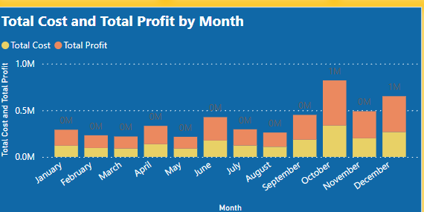
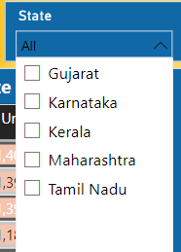
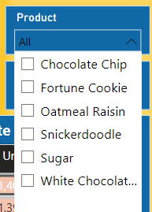
SALES REPORT AND INSIGHTS
The total cost and total profit for different months were analysed using stacked column chart.

Slide 5
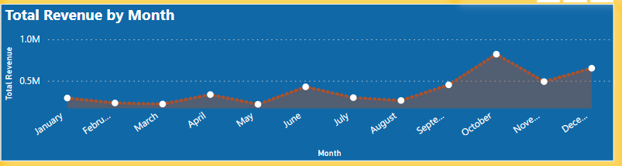
SALES REPORT AND INSIGHTS
The total revenue for different months were displayed in line chart for trend analysis.

Slide 6
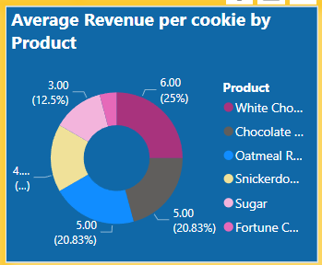
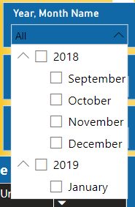
SALES REPORT AND INSIGHTS
The average revenue per cookie was analysed in donut chart in terms of type of the product.

Slide 7
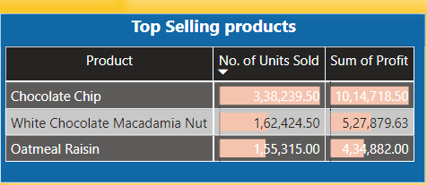
SALES REPORT AND INSIGHTS
The top 3 products based on the number of cookies sold and profit earned by the company from the year 2018 to 2019.

Slide 8
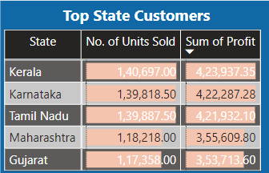
SALES REPORT AND INSIGHTS
The top customers were listed by states based on the number of cookies sold and profit earned by the company from the year 2018 to 2019.

Slide 9
THANK YOU..!!

